Slide 1
Human Shape from Silhouettes using Generative HKS Descriptors and Cross-Modal Neural Networks
Endri Dibra, Himanshu Jain, Cengiz Oztireli, Remo Ziegler, and Markus Gross
CVPR 2017
2018-06-27
Yucheng Lu

Slide 2
Contents
Introduction
Related works
Proposed method
Experiment result

Slide 3
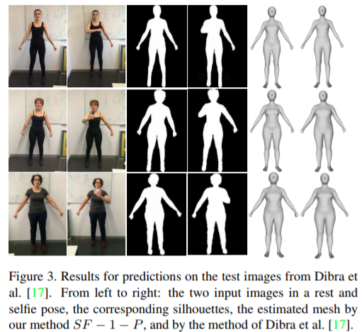
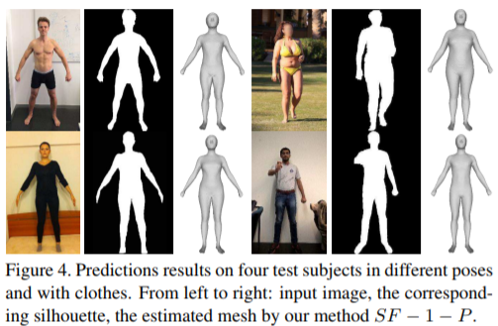
Introduction
This paper proposed a method for capturing human body shape from a single scaled silhouette, by combining deep correlated features capturing different 2D views, and embedding spaces based on 3D cues in a CNN architecture.

Slide 4
Related works
Body shape from an image:
estimate the parameters of the model by matching projected silhouettes of the 3D shapes to extracted image silhouettes.
Excellent results on 3D pose estimations, but lacking accuracy analysis on the generated body shapes.
CNNs on 3D shapes:
(1). present the 3D data as a low resolution voxelized grid.
Used in many general 2D to 3D shapes estimation methods.
(2). present the 3D shape from 3D shape descriptors, e.g. global point signature (GPS), heat kernel signature (HKS), and wave kernel signature (WKS).
Not be applied to maximize intra-class variance yet.

Slide 5
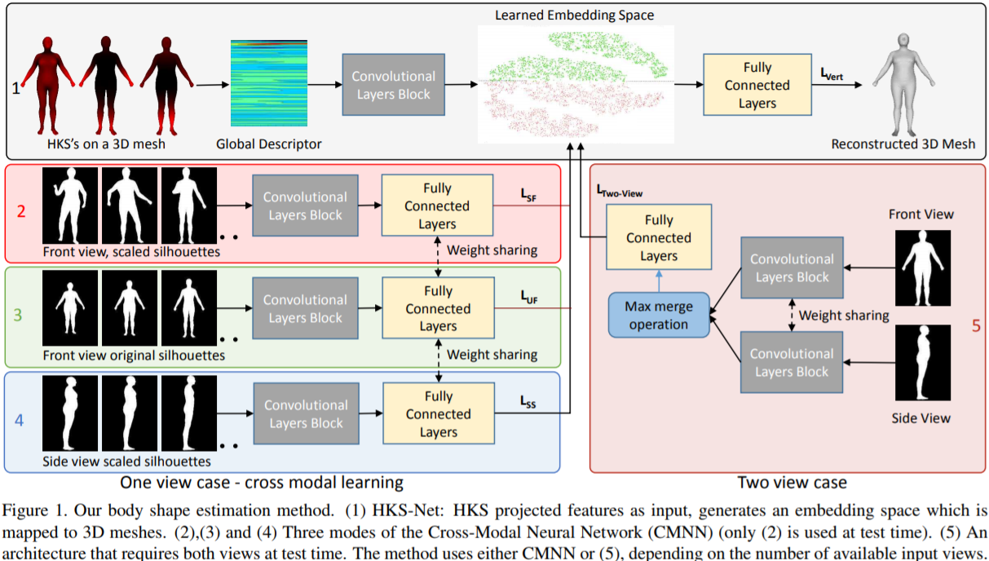
Proposed method

Slide 6
Proposed method
The proposed framework has three components:
(1). A network that learns an embedding space from extracted HKS features, and generates a 3D body mesh with neutral pose.
(2). A cross-modal CNN that leverages multi-view information at training time to boost single view predictions at test time.
(3). A test module from part(s) of cross-modal CNN.

Slide 7
Proposed method
Training data preparation:
CAESAR dataset (3D human body scans)
SCAPE (a set of 12,894 triangle deformations of a template 3D mesh with 6,449 vertices, controlled by pose parameters α and shape parameters β)
Linear Blend Skinning (extend the number of samples in SCAPE).
Final synthetic dataset consists of half million meshes, where the HKS features and silhouettes are used for training.

Slide 8
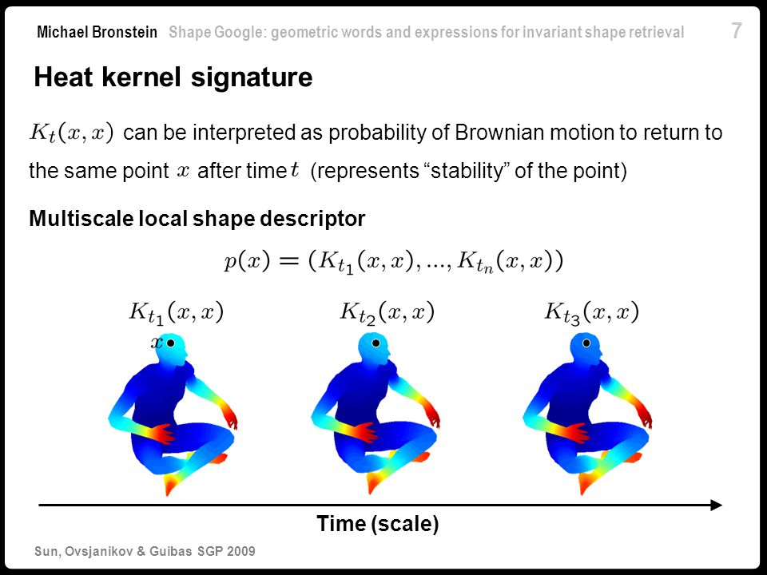
Proposed method
Heat Kernel Signature (HKS):

Slide 9
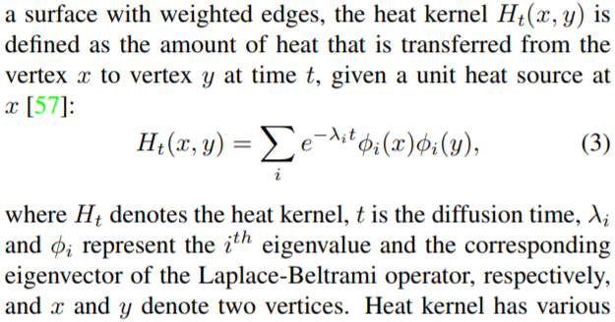
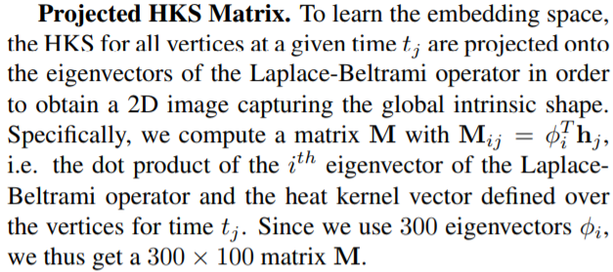
Proposed method
Heat Kernel Signature (HKS):

Slide 10
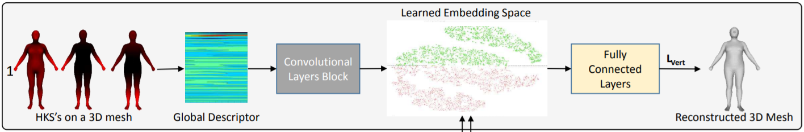
Proposed method
Heat Kernel Signature (HKS):
The embedding space has 4000 dimensions, learned by minimizing the per-vertex squared norm loss.
Visualized by T-SNE, green dots for female, red dots for male.

Slide 11
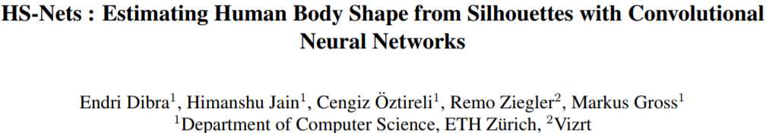
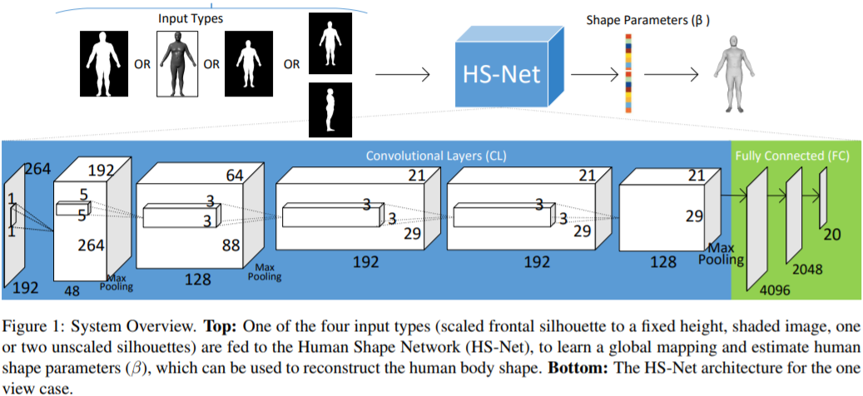
Proposed method
Cross-Modal Neural Network (CMNN):

Slide 12
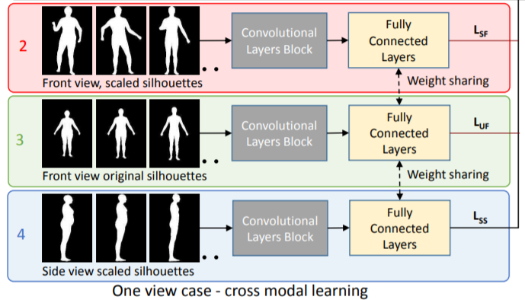
Proposed method
Cross-Modal Neural Network (CMNN):
-Unscaled means known camera calibration, scaled means resizing the silhouette to the same height.
-Each net is pre-trained individually. And they are jointly trained using all losses.

Slide 13
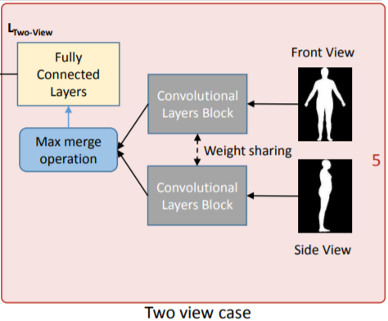
Proposed method
Testing Network:

Slide 14
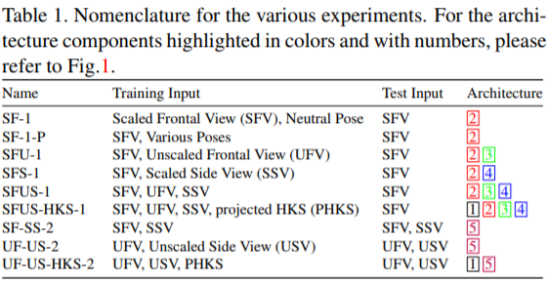
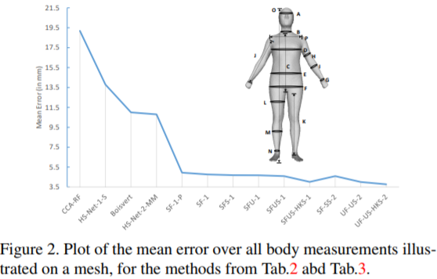
Experiment result

Slide 15
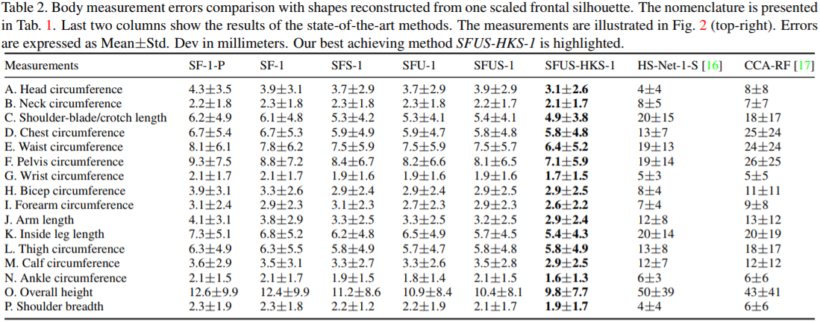
Experiment result

Slide 16
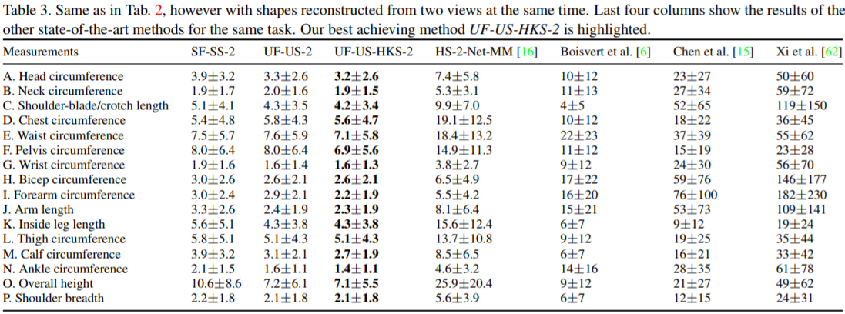
Experiment result

